Slide 1
Chi Square Test
Vinit Kumar

Slide 2
Also known as “test of association”
For qualitative data we need another method to analyse relationship between two variables.

Slide 3
Purpose
Our purpose will be :
To find out whether the two attributes are associated, and
To test the significance of such association.

Slide 4
Ex.
In the StatsLib there are some:
Students
Teachers
Research Scholars
Each group has varied reading habits.
To cater their needs the library procures books both General and Specialised in nature.

Slide 5
To meet the demand, to keep the stock in balance, the librarian needs to test whether the variables, i.e.,
The reading habit, and
The user groups
have any association.
The librarian starts with the first step….
The librarian collects the data.

Slide 6
And then second and third step …
The number of books issued on a particular day is as follows:
No of books Issued | Issued to |  |  | Row Totals
 | Students | Teachers | RS
General | 25 | 20 | 5 | 50
Specialised | 15 | 10 | 25 | 50
Column Totals | 40 | 30 | 30 | 100 Grand total

Slide 7
Then formulated hypotheses.
Hypothesis: is a tentative statement made about the expected or predicted relationship between two or more variables.
The statement may be or may not be true on being subjected to testing of the hypothesis.
For statistical tests we need to formulate two hypotheses.
Null hypothesis (H₀), and
Alternate Hypothesis (H₁)

Slide 8
Usually null hypothesis maintains the “status quo” or simply states the obvious.
Alternate hypothesis is the alternate to the null hypothesis.
There can be more than one alternate hypothesis but only one null hypothesis.
Coming back to our problem.

Slide 9
Back to example
The librarian made following hypothesis:
H₀: The preferences for books is independent of the user category.
H₁: The preferences for books is dependent upon or related to user category.

Slide 10
Expectations
In the table, we can see
Out of 100 books issued in a day 50 are general and 50 are specialised.
So, if the null hypothesis is true we expect that 50% of books issued to students should be ‘general’ in nature.
No of books Issued | Issued to |  |  | Row Totals
 | Students | Teachers | RS
General | 25 | 20 | 5 | 50
Specialised | 15 | 10 | 25 | 50
Column Totals | 40 | 30 | 30 | 100 Grand total

Slide 11
And similar % should hold good for research scholars and teachers too.
This is our expectation, but the practice may be different. We have to test whether the discrepancy is a chance or there is some genuine difference.
In order to test this we calculate “expected frequency” for each cell in the contingency table

Slide 12
Given by
Expected Frequency (fe)= (row total)X(column total)/grand total
So our expected frequency table becomes.
No of books Issued | Issued to |  |  | Row Totals
 | Students | Teachers | RS
General | 20 | 15 | 15 | 50
Specialised | 20 | 15 | 15 | 50
Column Totals | 40 | 30 | 30 | 100 Grand total

Slide 13
determining the critical region
Here we have degree of freedom(df) equal to 2.
While calculating the expected frequencies how much freedom we had?
Or how many expected frequencies we have to calculate.
We had to calculate three separate pieces of information with one restriction.
Df= 3-1 =2 , or
For a table df = (r-1)(c-1), r= no of rows and c= number of columns

Slide 14
In general you always lose one row and one column because of knowing the marginal totals, because the last row and column values can be calculate through subtraction.

Slide 15
To find the critical value, we will have to decide upon another parameter “Level of Significance”.
This is nothing but the significance level upto which you are going to accept the results.
After deciding upon this we can say “how significant is the difference between the observed and expected frequency?”
If we have confidence level of 95% the level of significance will be 0.05.
And for confidence level of 99% the level of significance will be 0.01.

Slide 16
Graph

Slide 17
To test the independence, we will apply Chi-square test.
The critical value of chi square for 2 df and 0.05 level of significance is 5.991.
This is obtained using probability table for chi square distribution.

Slide 18
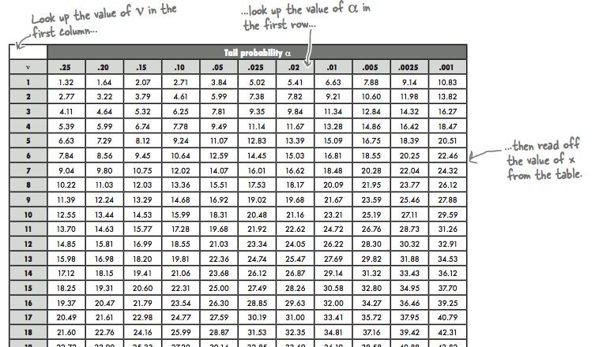

Slide 19
The next step is to calculate test parameter. i.e., chi square

Slide 20
Row/column | fo | fe | fo-fe | (fo-fe)^2 | (fo-fe)^2/fe
1-1 | 25 | 20
1-2 | 20 | 15
1-3 | 5 | 15
2-1 | 25 | 20
2-2 | 20 | 15
2-3 | 25 | 15
 |  |  |  | Total

Slide 21
analyse
See whether the test statistic is within the critical region.
Here the calculate value of chi square exceeds the critical value.

Slide 22
Make decision
Since the observed value of chi square exceeds the critical value, H₀ will be rejected and H₁ is accepted.
So we can infer out that
“Book preferences by users is related to the user groups”

Slide 23
Z Test
Used to compare sample mean and population mean.
In the yesterdays class we had seen this in detail.

Slide 24
T -test
Z tests are applicable only if there are thirty or more observations in the sample.
As the number of observations decreases, the distribution of Z diverges from a normal distribution.
known as Student’s’ distribution or the ‘t’ distribution

Slide 25
One sample, Testing against a value
A random sample of 10 athletes in a college had the IQ scores: 75, 115, 110, 102, 86,84,96,98,106, and 101
Do these data support the assumption of a population mean IQ of 105 at 1% level of significance?

Slide 26
Ho : µ= 105
H1 : µ≠ 105
t = X-

Slide 27
Comparing two samples (independent)
Volleyball | Basketball
64 | 60
58 | 48
62 | 60
58 | 68
60 | 58
59 | 59
50 | 55
58 | 65
65 | 56
59 | 50
The following are the vertical jump performance of volleyball and basketball players in cms.
Test, if the two groups differ significantly in relation to the performance on vertical jump.

Slide 29
One sample, two measures(paired)
testing the impact.
An awareness programmme was given to 10 women on personal hygiene. A test was administered before and after the awareness programme which is shown in the following table.
can it be concluded at .05 level of significance that the awareness programme in general increases the knowledge of personal hygiene?

Slide 30
Pre | Post
15 | 15
11 | 13
12 | 15
11 | 15
13 | 15
13 | 14
13 | 16
12 | 13
12 | 15
12 | 12

